Slide 1
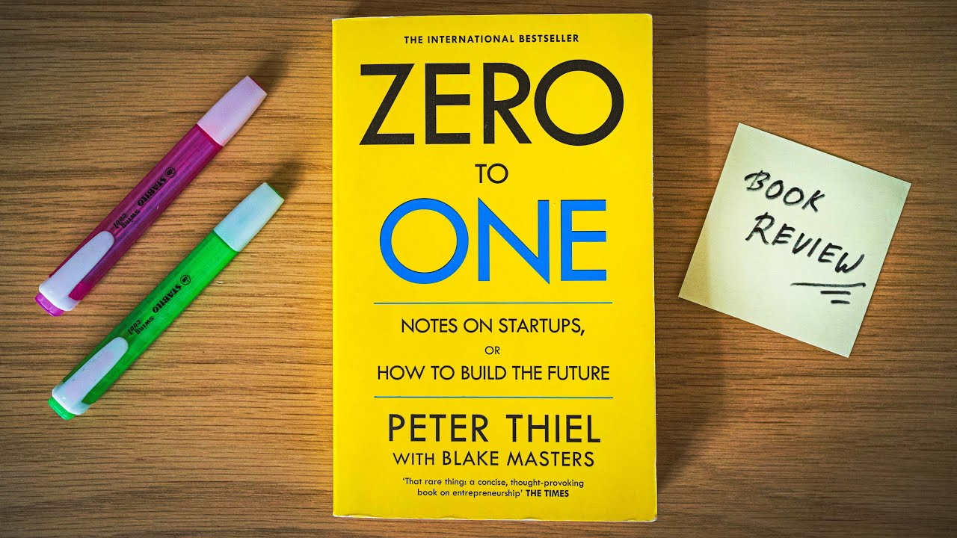
-SHANTANU BHUTE (24201796)

Slide 3


Learn to go from zero : 1

Slide 4
02. Ask Contrarian Questions

Slide 5
03. Avoid Competitions
Amazon

Slide 6
04. Build Monopolies
1. Proprietory Technology eg Google,
2. Network Effects eg FB,
3.Economy of scale eg . twitter
4. Branding eg Apple, Amazon (avoid disrupting the market ..dominate a specific niche and scale it don’t do like Napster became huge in music industry then bankrupt)

Slide 7
05. Become Definite Optimist

Slide 8
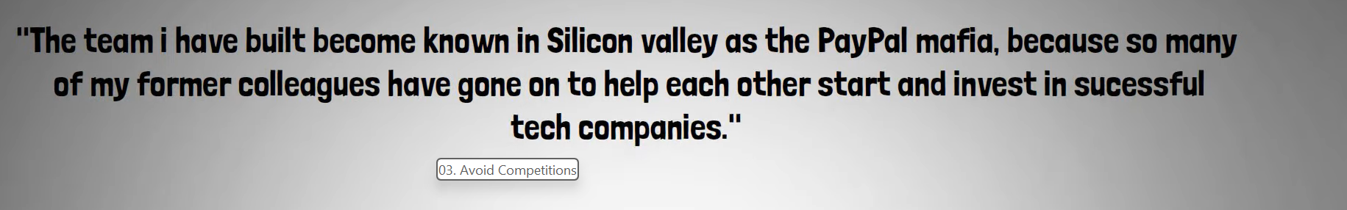
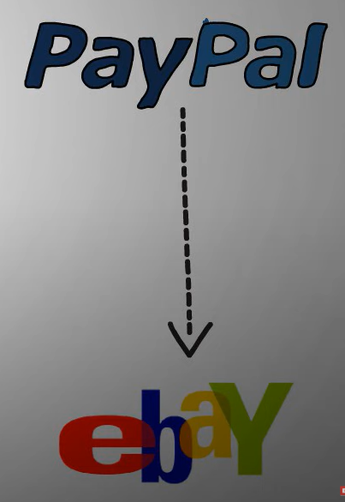
Assemble a perfect Team
Elon musk Space X and tesla
linked in
youtube
yelp
yammer
Palantir
1.5 billion to ebay in 2002

